Slide 1
IMPACT OF TERRORISM ON FOREIGN DIRECT INVESTMENT(FDI), GROSS DOMESTIC PRODUCT (GDP), DEFENCE, NET TRADE AND UNEMPLOYMENT
GROUP 5 :
SAYANI BODHAK
DEBASMITA SAHA
PRACHI BISWAS
ROZMIN ALI

Slide 2
CONTENTS
ABSTRACT
INTRODUCTION
LITERATURE REVIEW
OBJECTIVES
METHODOLOGY AND RESULTS
COMPARISON BETWEEN INDIA AND PAKISTAN WITH RESPECT TO GDP, FDI, DEFENCE, UNEMPLOYMENT AND NET TRADE
POLICIES TO REDUCE TERRORIST ATTACKS AND WAYS TO GET A STABLE ECONOMY
CONCLUSION
REFERENCES

Slide 3
ABSTRACT
This paper studies the impact of terrorist attacks on FDI inflows by economic sector in India. It shows the correlation between terrorist attacks and other four variables GDP, unemployment, defense and net trade. In India there is a negative correlation of terrorist attacks with FDI and GDP where as a positive correlation with unemployment, defense and net trade. This paper also shows the comparison between India and Pakistan with respect to those five variables how these variables are related to each other. And finally it suggests some policy implications taken by the government to reduce terrorist attacks.

Slide 4
INTRODUCTION
Terrorism is a form of violence and intimidation that is carried out by individuals, groups or governments to achieve political or ideological goals. According to the Oxford English Dictionary, terrorism is defined as "the unlawful use of violence and intimidation, especially against civilians, in the pursuit of political aims”.
Foreign direct investment (FDI) refers to the investment made by a company or an individual from one country into a business or project located in another country.
Gross Domestic Product (GDPis a measure of the total monetary value of all final goods and services produced within a country's borders during a specific period, typically a year.
Unemployment due to terrorism refers to a specific type of unemployment that arises as a result of terrorist activities and their impact on the economy. It occurs when individuals lose their jobs or are unable to find employment opportunities due to the disruptive effects of terrorism on economic activities.
Net Trade is the value of nation’s total export of goods and services minus total import of goods and services.

Slide 5
LITERATURE REVIEW
NAMES | FINDINGS
Mir Alam, Ye Mingque (2018) | They analyzes the relationship between FDI, terrorism and tourism in Pakistan using annual data from 1995 to 2016. It is observed that in the long run a 1% increase in terrorists’ incidence leads to decrease FDI 0.42% FDI and 0.14% TA.
Haider, N., & Anwar, A. (2014) | They evaluated the effect terrorism on FDI inflows, and noted that terrorist attacks have badly affected the FDI inflow in Pakistan.
Lee, C. Y. (2017) | He analyzed the dynamics of terrorism in 114 developing countries. The results showed that terrorism had a negative impact on FDI. Moreover, he concluded that counter-terrorism aid given to panic-stricken countries helps them to recover from losses.

Slide 6
NAMES | FINDINGS
Blomberg et al. (2011) | He concluded that terrorism is a global phenomenon which does not seem to be reduced, but meta analysis on studies focussed on the association between FDI inflows and terrorist attacks.
Enders & Sandler (2003) | They found out that terrorism significantly and substantially reduces the amount of FDI globally and has a negative impact on inward foreign investment. They even concluded that transnational terrorism has a statistically significant effect upon FDI in OECD countries.
Siddique, H. M. A. and Liqat, R. and Ullah, K. (2017). | They found that there is a negative impact of terrorism on Foreign Domestic Investment and Domestic Investment in Pakistan during 1980-2015 in Pakistan.

Slide 7
NAMES | FINDINGS
Feridun and Shahbaz (2010) | They have found that the relationship between military expenditure and terrorist attacks can have both negative and positive perspectives.
Blomberg & Hess (2004) | Terrorism creates uncertainty, leading to the postponement of long-term investments or increased government spending on security at the expense of (more productive) spending on education and infrastructure, which ultimately reduces growth
Ranjan Kumar Mohanty, Sidheswar Panda, Biswabhusan Bhuyan (2020) | The empirical analysis shows that defence expenditure positively affects economic growth both in the long run and short run. Further, while capital defence spending has a positive and significant effect on economic growth in both the short run and the long run, revenue defence expenditure does not have any significant effect in the long run and short run.

Slide 8
NAMES | FINDINGS
Malik Shahzad Shabbir, Maleeha Kiyani, Aniqa Zeb (2019) | The analysis stated that terrorism does not only affect the economy, it creates the worst environment for international investors to withdraw their investment for that particular country, and India is the one of them. When investors withdraw their investment for partially or fully, this affects FDI of India.
Malik Shahzad Shabbir, Maleeha Kiyani, Aniqa Zeb (2008) | It showed that a relatively small increase in the perceived risk of terrorism can cause an outsized reduction in a country’s net stock of foreign direct investment and inflict significant damage on its economy.
Bandyopadhyay, Sandler, and Younas, (2015) | They found that on average a relatively small increase in a country’s domestic terrorist incidents reduced net foreign direct investment. There was a similarly large reduction in net investment if the terrorist incidents originated abroad or involved foreigners or foreign assets in the attacked country.

Slide 9
OBJECTIVES
In this paper there are two objectives:
To investigate the impact of Terrorism on FDI, GDP , Net Trade , Unemployment and Defence expenditure of INDIA and PAKISTAN . We have compared the results of both the countries.
To look for appropriate policies to reduce or curb the terrorist attacks so that we can maintain a long lasting economic growth.

Slide 10
METHODOLOGY AND RESULTS

Slide 11
The study starts off by examining the sample of Terrorist Attacks on FDI inflows, GDP, Defence sector, Unemployment sector and Net trade of the Indian Economy. We then find the data of our neighboring country Pakistan to compare between the countries on the basis of all five variables.
The given data shows the number of Terrorist Attacks, FDI inflows (in percentage of GDP), GDP, Defence (in terms of US billion dollars), Unemployment ( in percentage of total labor force) and Net trade over the years from 2000-2021 for India and Pakistan.
In order to statistically quantify the relationship, we find the pairwise correlation between number of Terrorist attacks (independent variable) and FDI, GDP, Defence, Unemployment and Net Trade, all being dependent variables.
[Source: the data for the five variables has been collected from WORLD DATA BANK (https://data.worldbank.org/)
and Terrorist Attacks from SOUTH ASIA TERRORISM PORTAL (SATP) (https://www.satp.org/)].

Slide 12
PAIRWISE CORRELATION
AMONG VARIABLES
“THE CASE FOR INDIA”

Slide 13
FDI AND TERRORIST ATTACKS
The above data shows the pairwise correlation between FDI(% OF GDP )and TERRORIST ATTACKS TOTAL NO OF ATTACKS, which is negative (i.e., -0.4490); indicating that as number of terrorist attacks decreases, FDI of India (% of GDP) increases and vice-versa. This is because terrorism and FDI is inversely related to each other.
The correlation between FDIOFGDP and FDIOFGDP & TERRORISTA~A and TERRORISTA~A shows the value 1.0000. This is because the correlation between any variable and itself is always 1.

Slide 14
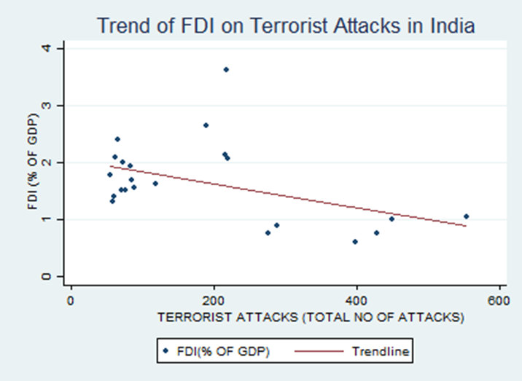
GRAPH FOR FDI AND TERRORIST ATTACKS
The relationship between FDI AND Terrorists attacks in in India is negative.

Slide 15
GDP AND TERRORIST ATTACKS
The above data shows the pairwise correlation between GDP (CURRENT US) and TERRORIST ATTACKS (TOTAL NO OF ATTACKS), which is negative (i.e., -0.8680); indicating that as number of terrorist attacks decreases, GDP of India increases and vice-versa. This is because terrorism and GDP is inversely related to each other.
The correlation between GDP(CURRENT US) and GDP(CURRENT US) & TERRORIST A~A and TERRORISTA~A shows the value 1.0000. This is because the correlation between any variable and itself is always 1.

Slide 16
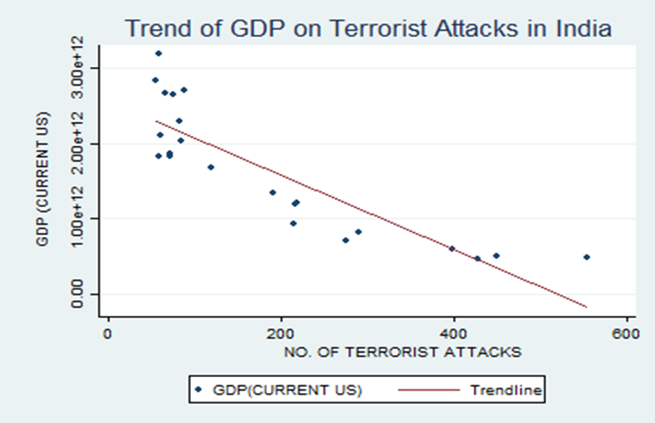
GRAPH FOR GDP AND TERRORIST ATTACKS
The relationship between GDP AND Terrorists attacks in India is negative.

Slide 17
DEFENCE AND TERRORIST ATTACKS
The above data shows the pairwise correlation between DEFENCE (BILLIONS OF US DOLLARS) and TERRORISTATTACKS (TOTAL NO OF ATTACKS), which is positive (i.e., 0.6327); indicating that as the number of terrorist attacks decreases, defence (in terms of US billion dollars) also decreases and vice-versa.
The correlation between DEFENCEBIL~S and DEFENCEBIL~S & TERRORISTA~A and TERRORISTA~A shows the value 1.0000. This is because the correlation between any variable and itself is always 1.

Slide 18
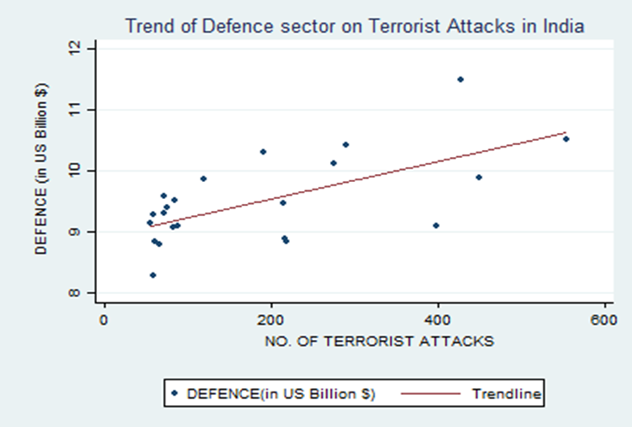
GRAPH FOR DEFENCE AND TERRORIST ATTACKS
The relationship between Defence and Terrorists attacks in India is positive.

Slide 19
UNEMPLOYMENT AND TERRORIST ATTACKS
The above data shows the pairwise correlation between unemployment (total % of total labor force) and TERRORIST ATTACKS TOTAL NO OF ATTACKS, which is positive (i.e., 0.0951); indicating that as the number of terrorist attacks decreases, unemployment (% of total labor force) also decreases and vice-versa. This happens because terrorism and unemployment are proportional to each other.
The correlation between unemployme~a and unemployme~a & TERRORISTA~A and TERRORISTA~A shows the value 1.0000. This is because the correlation between any variable and itself is always 1.

Slide 20
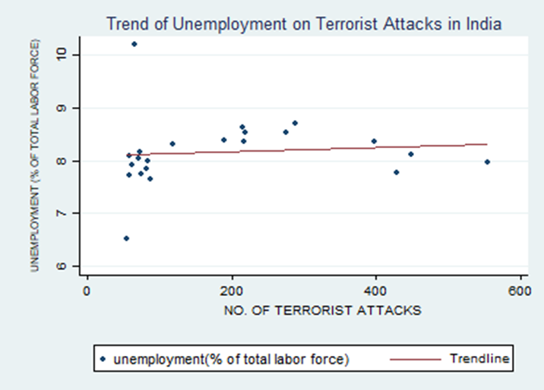
GRAPH FOR UNEMPLOYMENT AND TERRORIST ATTACKS
A positive relation is noticed between unemployment (% of total labor force) and number of terrorist attacks in India.

Slide 21
NET TRADE AND TERRORIST ATTACKS
The above data shows the pairwise correlation between NET TRADE IN GOODS AND SERVICES and TERRORIST ATTACKS TOTAL NO OF ATTACKS, which is positive (i.e., 0.7190); indicating that as the number of terrorist attacks decreases, net trade in goods and services also decreases and vice-versa. This happens because terrorism and net trade are proportional to each other.
The correlation between NETTRADEIN~S and NETTRADEIN~S & TERRORISTA~A and TERRORISTA~A shows the value 1.0000. This is because the correlation between any variable and itself is always 1.

Slide 22
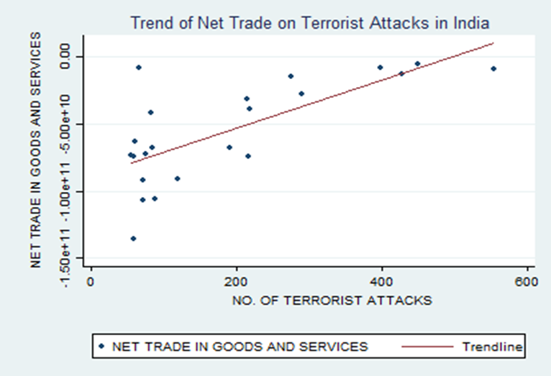
GRAPH FOR NET TRADE AND TERRORIST ATTACKS
A positive relation is noticed between Net trade and number of Terrorist Attacks in India.

Slide 23
PAIRWISE CORRELATION
AMONG VARIABLES
“THE CASE FOR PAKISTAN”

Slide 24
FDI AND TERRORIST ATTACKS
The above data shows the pairwise correlation between FDI IN GDP and TERRORIST ATTACKS, which is positive (i.e., 0.1320); indicating that as number of terrorist attacks decreases, FDI of Pakistan (% of GDP) decreases and vice-versa. But, as we know, terrorism and FDI is inversely related to each other; in our data, for the given time period, we are getting a positive relation between terrorist attacks and FDI of Pakistan.
The correlation between FDI IN GDP and FDI IN GDP & TERRORISTS~S and TERRORISTS~S shows the value 1.0000. This is because the correlation between any variable and itself is always 1.

Slide 25
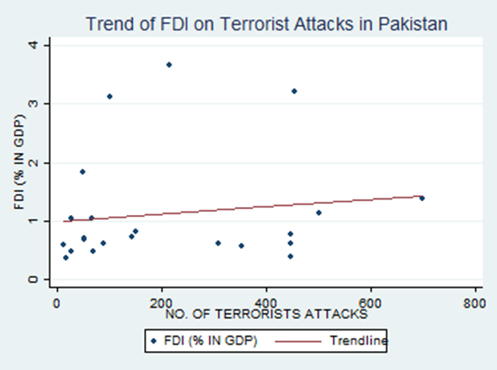
GRAPH FOR FDI AND TERRORIST ATTACKS
There is a slight positive relation between FDI and number of terrorist attacks in Pakistan.

Slide 26
GDP AND TERRORIST ATTACKS
The above data shows the pairwise correlation between GDPCURRENTUSA and TERRORISTATTACKS, which is positive (i.e., 0.0749); indicating that as number of terrorist attacks decreases, GDP of Pakistan decreases and vice-versa. But, as we know, terrorism and GDP is inversely related to each other; in our data, for the given time period, we are getting a positive relation between terrorist attacks and GDP of Pakistan.
The correlation between GDPCURRENT~A and GDPCURRENT~A & TERRORISTS~S and TERRORISTS~S shows the value 1.0000. This is because the correlation between any variable and itself is always 1.

Slide 27
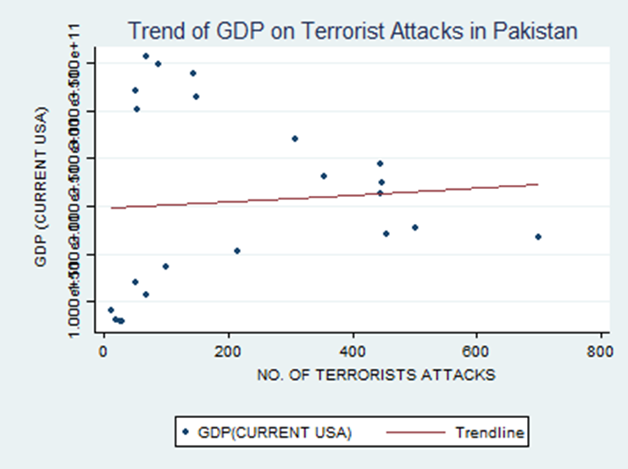
GRAPH FOR GDP AND TERRORIST ATTACKS
.
The relationship between Terrorist Attacks and GDP of Pakistan is positive.

Slide 28
DEFENCE AND TERRORIST ATTACKS
The above data shows the pairwise correlation between DEFENCEUSBILLION and TERRORIST ATTACKS, which is negative (i.e., - 0.6859); indicating that as number of terrorist attacks decreases, defence (in terms of US billion dollars) increases and vice-versa. But, as we know, terrorism and defence is proportional to each other; in our data, for the given time period, we are getting a negative relation between terrorist attacks and defence sector of Pakistan.
The correlation between DEFENCEUSB~N and DEFENCEUSB~N & TERRORISTS~S and TERRORISTS~S shows the value 1.0000. This is because the correlation between any variable and itself is always 1.

Slide 29
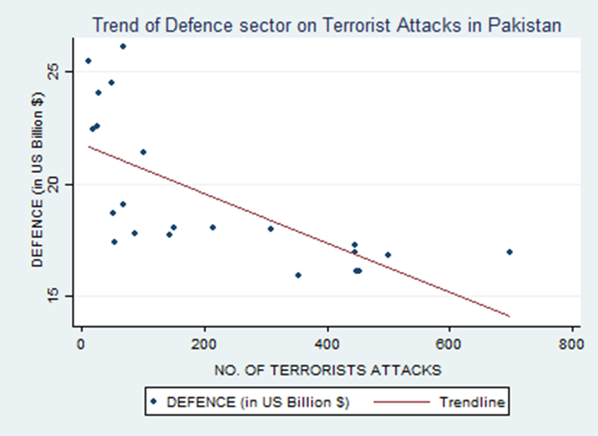
GRAPH FOR DEFENCE AND TERRORIST ATTACKS
The relationship between Defence and Terrrorist Attacks is negative.

Slide 30
UNEMPLOYMENT AND TERRORIST ATTACKS
The above data shows the pairwise correlation between unemployment(total % of total labour force) and TERRORIST ATTACKS, which is negative (i.e., - 0.2482); indicating that as number of terrorist attacks decreases, unemployment (% of labor force) increases and vice-versa. But, as we know, terrorism and unemployment is proportional to each other; in our data, for the given time period, we are getting a negative relation between terrorist attacks and unemployment sector of Pakistan.
The correlation between unemployme~a and unemployme~a & TERRORISTS~S and TERRORISTS~S shows the value 1.0000. This is because the correlation between any variable and itself is always 1.

Slide 31
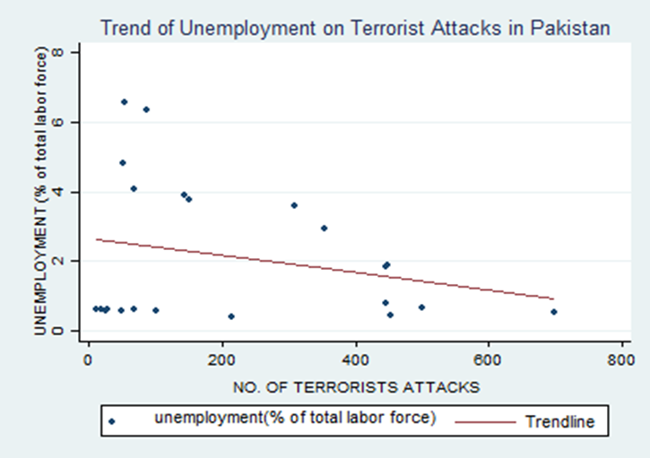
GRAPH FOR UNEMPLOYMENT AND TERRORIST ATTACKS
We notice a negative relation between unemployment and Terrorist Attacks in Pakistan.

Slide 32
NET TRADE AND TERRORIST ATTACKS
The above data shows the pairwise correlation between NET TRADE IN GOODS AND SERVICES and TERRORIST ATTACKS, which is negative (i.e., - 0.0735); indicating that as number of terrorist attacks decreases, net trade in goods and services increases and vice-versa. But, as we know, terrorism and net trade is proportional to each other; in our data, for the given time period, we are getting a negative relation between terrorist attacks and net trade of Pakistan.
The correlation between NETTRADEIN~S and NETTRADEIN~S & TERRORISTS~S and TERRORISTS~S shows the value 1.0000. This is because the correlation between any variable and itself is always 1.

Slide 33
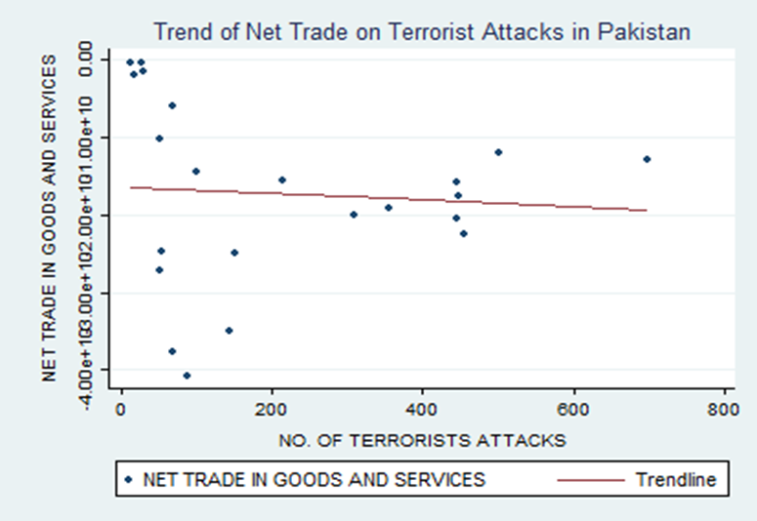
GRAPH FOR NET TRADE AND TERRORIST ATTACKS
The relationship between Net Trade and Terrorist Attacks is negative.

Slide 34
COMPARISON BETWEEN INDIA AND PAKISTAN WITH RESPECT TO GDP, FDI, DEFENCE, UNEMPLOYMENT AND NET TRADE (Source- the data of the five variables has been collected from WORLD DATA BANK and Terrorist Attacks from SOUTH ASIAN TERRORISM PORTAL (SATP) )

Slide 35
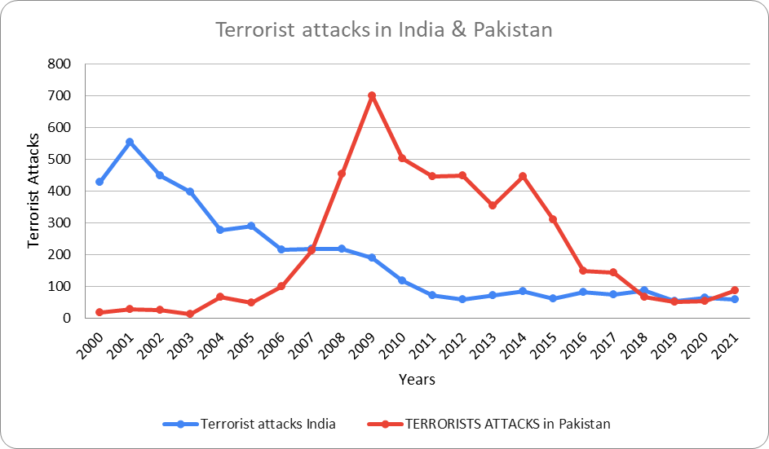
COMPARISON OF TERRORIST ATTACKS IN BOTH THE COUNTRIES
The number of Terrorist Attacks are increasing in PAKISTAN whereas decreasing in INDIA.
The above diagram shows the number of terrorist attacks from 2000-2021 in India and Pakistan.

Slide 36
FDI SECTOR
On comparing between India and Pakistan with respect to number of terrorist attacks on FDI sector of both the countries, we find that FDI is negatively correlated with terrorist attacks (i.e., -0.4490) in India whereas, it is positively correlated with terrorist attacks (i.e., 0.1320) in Pakistan. This is because FDI is inversely related to terrorism. For India, it is negative for the given time period and for Pakistan, it is positive for the given time period; but both are following the trend of inverse relation between FDI and terrorist attacks.

Slide 37
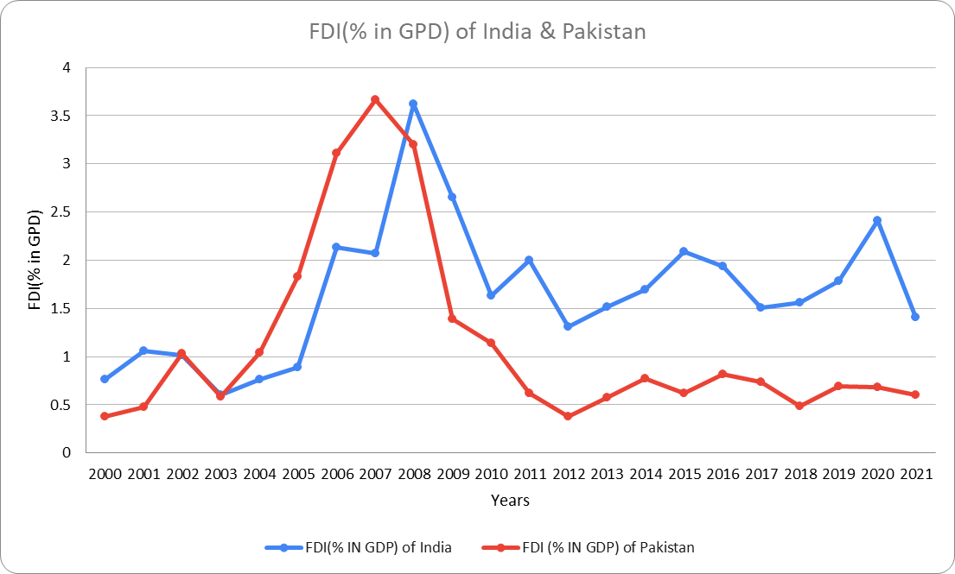
COMPARISON OF FDI SECTOR IN BOTH THE COUNTRIES
In both the countries FDI is fluctuating but in India it is even more than Pakistan due to Terrorist Attacks.
The above diagram shows the change in the FDI of India and Pakistan from period 2000-2021.

Slide 38
GDP SECTOR
On comparing between India and Pakistan with respect to number of terrorist attacks on GDP sector of both the countries, we find that GDP is negatively correlated with terrorist attacks (i.e., -0.8680) in India whereas, it is positively correlated with terrorist attacks (i.e., 0.0749) in Pakistan. This is because GDP is inversely related to terrorism. For India, it is negative for the given time period and for Pakistan, it is positive for the given time period; but both are following the trend of inverse relation between GDP and terrorist attacks.

Slide 39
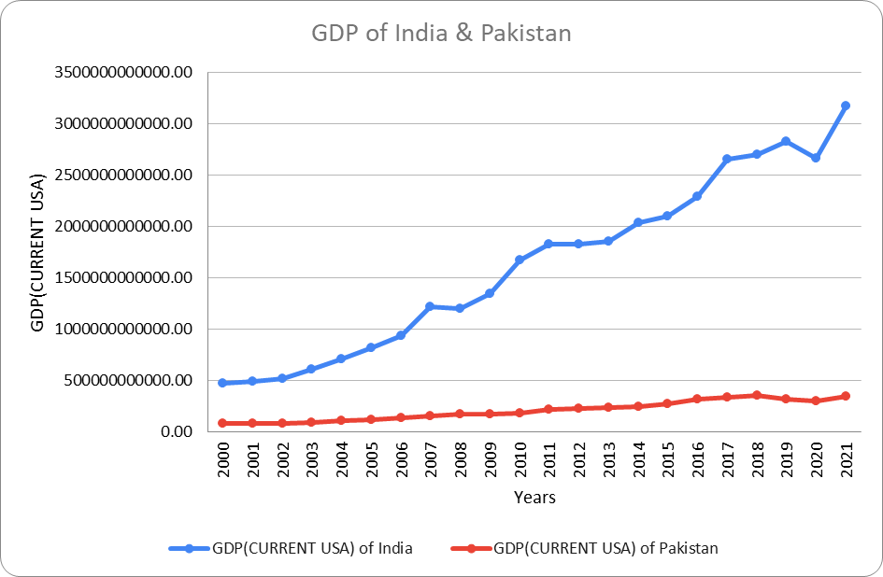
COMPARISON OF GDP SECTOR IN BOTH THE COUNTRIES
The GDP in INDIA is increasing whereas in PAKISTAN it is slightly increasing.
The above diagram shows the change in GDP in India and Pakistan between period 2000-2021.

Slide 40
DEFENCE SECTOR
On comparing between India and Pakistan with respect to number of terrorist attacks on defence sector of both the countries, we find that defence is positively correlated with terrorist attacks (i.e., 0.6327) in India whereas, it is negatively correlated with terrorist attacks (i.e., -0.6859) in Pakistan. This is because defence is proportional to terrorism. For India, it is positive for the given time period and for Pakistan, it is negative for the given time period; but both are following the trend of proportional relation between defence and terrorist attacks.

Slide 41
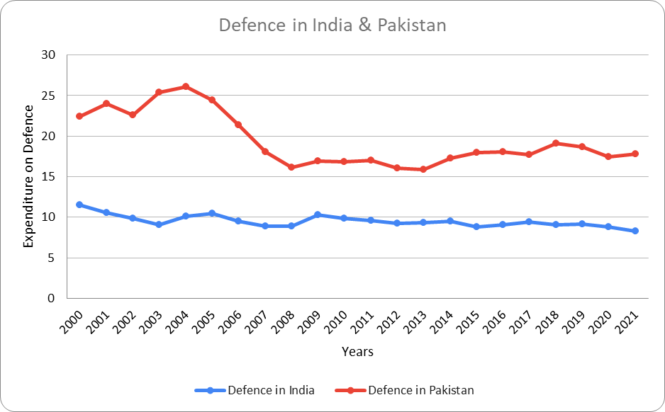
COMPARISON OF DEFENCE SECTOR IN BOTH THE COUNTRIES
The Defence Sector in INDIA is slightly fluctuating but in PAKISTAN it is highly fluctuating.
The above diagram shows the change in Defence in India and Pakistan from 2000-2021.

Slide 42
UNEMPLOYMENT SECTOR
On comparing between India and Pakistan with respect to number of terrorist attacks on unemployment sector of both the countries, we find that unemployment is positively correlated with terrorist attacks (i.e., 0.0951) in India whereas, it is negatively correlated with terrorist attacks (i.e., -0.6295) in Pakistan. This is because unemployment is proportional to terrorism. For India, it is positive for the given time period and for Pakistan, it is negative for the given time period; but both are following the trend of proportional relation between unemployment and terrorist attacks.

Slide 43
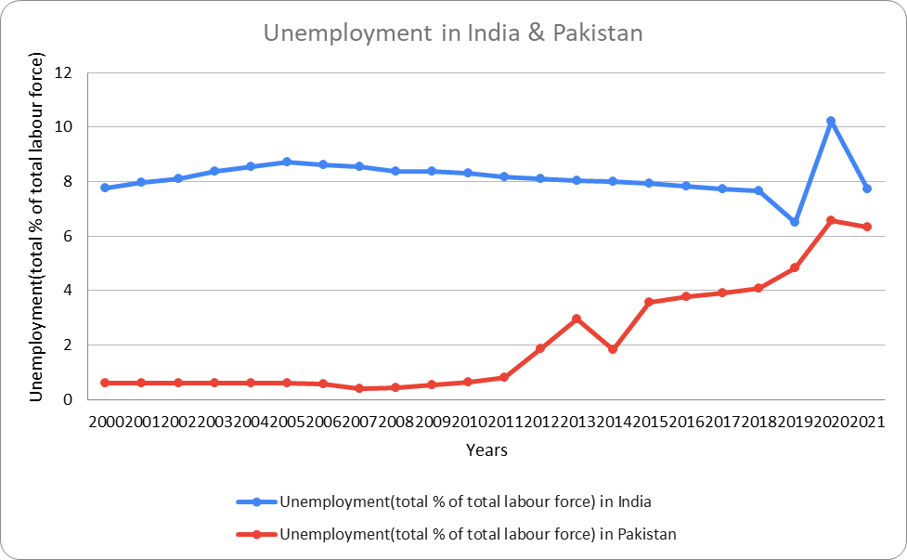
COMPARISON OF UNEMPLOYMENT SECTOR IN BOTH THE COUNTRIES
In India, it is slightly fluctuating.
In Pakistan, unemployment is increasing at an increasing rate.
The above diagram shows the change of Unemployment in India and Pakistan from 2000-2021.

Slide 44
NET TRADE SECTOR
On comparing between India and Pakistan with respect to number of terrorist attacks on net trade in goods and services of both the countries, we find that net trade is positively correlated with terrorist attacks (i.e., 0.7190) in India whereas, it is negatively correlated with terrorist attacks (i.e., -0.0735) in Pakistan. This is because net trade is proportional to terrorism. For India, it is positive for the given time period and for Pakistan, it is negative for the given time period; but both are following the trend of proportional relation between net trade and terrorist attacks.

Slide 45
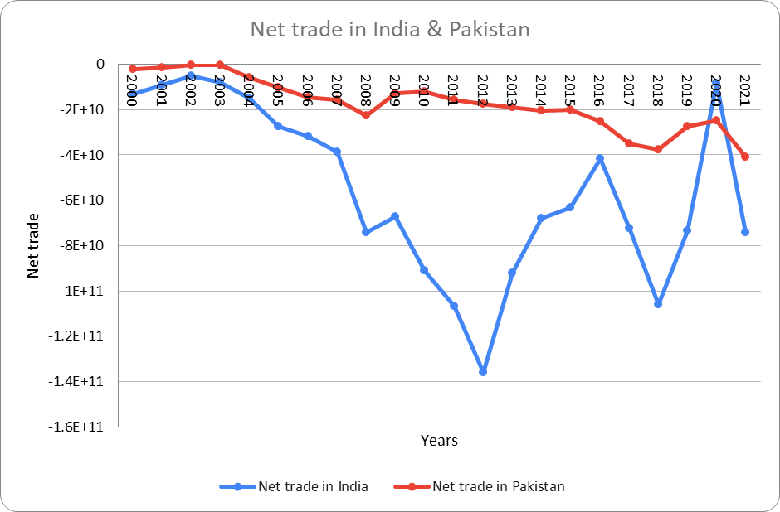
COMPARISON OF NET TRADE SECTOR IN BOTH THE COUNTRIES
In India , Net Trade is decreasing at a greater rate than Pakistan because of excess imports.
The above diagram shows change in Net Trade in India and Pakistan from 2000-2021.

Slide 46
POLICIES TO REDUCE TERRORIST ATTACKS AND WAYS TO GET A STABLE ECONOMY

Slide 47
Counterterrorism Measures: Governments can adopt comprehensive counterterrorism strategies that include intelligence gathering, surveillance, and preventive actions to identify and disrupt terrorist activities. This involves collaboration among law enforcement agencies, international cooperation, and sharing of intelligence to effectively combat terrorism.
Enhance Security Measures: Strengthening security measures is crucial to prevent terrorist attacks and ensure public safety. This may involve enhancing border security, implementing stringent airport and transportation security protocols, securing critical infrastructure, and increasing security presence in public spaces.
Address Root Causes: To address the underlying factors that contribute to terrorism, policies should focus on addressing socio-economic grievances, inequality, and political instability. This can include promoting social inclusion, improving access to education and healthcare, reducing poverty, and promoting good governance and political reforms.
International Cooperation: Terrorism is a global issue, and cooperation among nations is essential. Sharing intelligence, coordinating efforts to track and freeze terrorist financing, and collaborating in investigations and prosecutions can help disrupt transnational terrorist networks.

Slide 48
Community Engagement and Countering Extremist Ideologies: Governments can work with local communities, civil society organizations, and religious leaders to counter extremist ideologies and promote social cohesion. This can involve initiatives such as community outreach programs, promoting interfaith dialogue, and supporting rehabilitation and reintegration programs for individuals vulnerable to radicalization.
Regarding achieving a stable economy, the following measures can be considered:-
Macroeconomic Stability: Implementing sound monetary and fiscal policies that promote price stability, low inflation rates, and sustainable public finances can contribute to economic stability. This includes maintaining a balanced budget, effective tax policies, and prudent management of monetary policy.
Investment in Infrastructure: Investing in infrastructure development can stimulate economic growth, create jobs, and attract private investment. Improving transportation networks, energy systems, and telecommunications infrastructure can enhance productivity and competitiveness

Slide 49
Promote Business Environment: Creating a conducive business environment through policies that encourage entrepreneurship, innovation, and private sector growth is essential for economic stability. This can involve reducing bureaucracy, streamlining regulations, ensuring the rule of law, protecting property rights, and facilitating access to finance for businesses.
Human Capital Development: Investing in education and skills training equips the workforce with the necessary knowledge and skills to drive economic growth. This can involve improving access to quality education, vocational training, and lifelong learning opportunities.
Trade and Investment Liberalization: Promoting open and fair trade, reducing barriers to international trade and investment, and participating in regional and global trade agreements can enhance economic stability and create opportunities for businesses to expand.

Slide 50
CONCLUSION
The purpose of the present study is the empirical investigation of the interaction between Terrorist Attacks and FDI, GDP, Defence, Unemployment and Net Trade in India during the period 2000-2021. In addition to this, we studied Pakistan to compare under the criterion that this country presented the highest rates of terrorism in the world.
This study has shown a significant but inconsistent relationship between terrorist attacks and foreign direct investment and gross domestic product but, provided a consistent relationship with defence sector, unemployment sector and net trade in goods and services for India.

Slide 51
There is a negative correlation between FDI and Terrorist Attacks in India, but a positive relationship between these two in Pakistan.
There is a negative relationship between GDP and Terrorist Attacks in India but a positive relationship between the two variables in Pakistan.
There is a positive relationship among Defence, Unemployment and Net Trade with Terrorist Attacks in India but a negative one in Pakistan.

Slide 52
REFERENCES
Enders et al.,(2006). The Impact of Transnational Terrorism on U.S. Foreign Direct Investment.
Blomberg et al.,(2011). Terrorism and the economics of trust. Journal of Peace Research, 48(3), 383–398. [https://doi.org/10.1177/0022343311401641].
Sandler & Enders,(2003). ECONOMIC CONSEQUENCES OF TERRORISM IN DEVELOPED AND DEVELOPING COUNTRIES: AN OVERVIEW.
Murtaza & Amar,(2014). Impact of terrorism on FDI flows to Pakistan. Toronto.
Siddique et al.,(2017). Impact of Terrorism on Investment: Evidence from Pakistan. Vol. 6, Bulletin of Business and Economics.
Shabbir et al.,(2019). Impact of Terrorism on Exclusive Indian Economy. Vol. 5, Journal of Indian Studies 29 Journal of Indian Studies.
Mohanty et al.,(2020). Does Defence Spending and its Composition Affect Economic Growth in India? Margin. Feb 1;14(1):62–85.

Slide 53
Alam & Mingque,(2018).The Relationship between Terrorist Events, Foreign Direct Investments (FDI) and Tourism Demand: Evidence from Pakistan. American Journal of Tourism Management [Internet]. 7(1):10–8. [Available from: http://journal.sapub.org/tourism].
Bandyopadhyay et al.,(2015). The Toll of Terrorism.
Feridun & Shahbaz,(2010). Fighting terrorism: Are military measures effective? Empirical evidence from Turkey. Defence and Peace Economics. Apr;21(2):193–205.
Blomberg et al.,(2004). Economic conditions and terrorism. Eur J Polit Econ [Internet]. 20(2):463–78. [Available from: https://www.sciencedirect.com/science/article/pii/S0176268004000217].
Lee,(2017) Terrorism, Counterterrorism Aid, and Foreign Direct Investment. Foreign Policy Analysis [Internet]. 13(1):168–87. [Available from: https://www.jstor.org/stable/26168140].

Slide 54
NO. OF TERRORIST ATTACKS IN INDIA, n.d. [https://www.satp.org/datasheet-terrorist-attack/major-incidents/india].
NO. OF TERRORIST ATTACKS IN PAKISTAN, n.d. [https://www.satp.org/datasheet-terrorist-attack/major-incidents/pakistan].

Slide 55
THANK YOU

